Slide 1

PREDICTING CUSTOMER BUYING BEHAVIOUR
1/1/2024

Slide 2
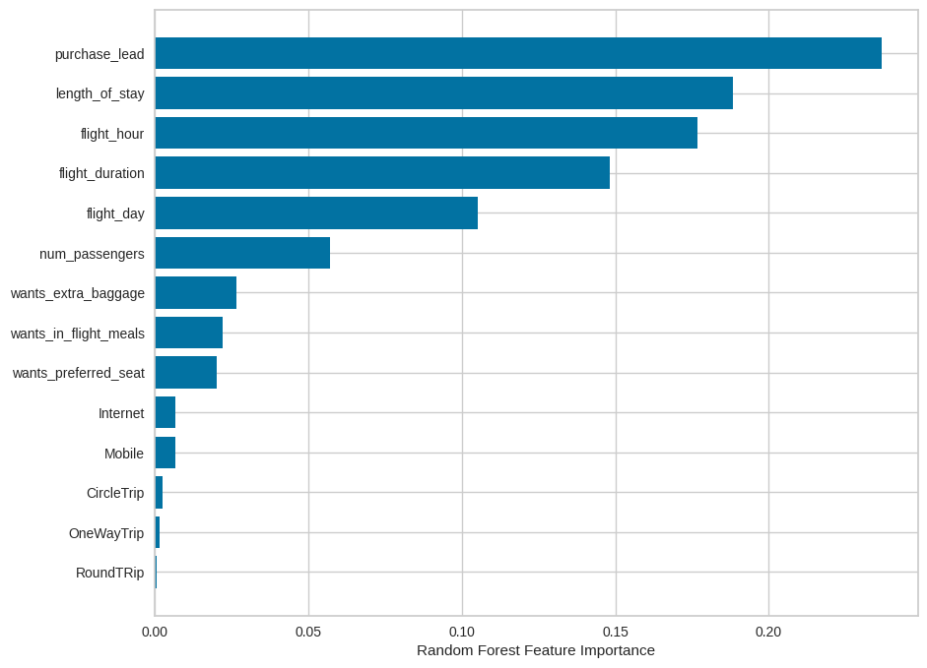
PREDICTIVE MODEL TO UNDERSTAND FACTORS THAT INFLUENCE BUYING BEHAVIOUR
I have trained the data set with Random forest classifier model and received
Accuracy, precision, recall and f1-score for training data are 0.61, 0.6, 0.58, 0.65 and 0.59 respectively.

